Slide 1

Revenue and Profit Analysis
Analysis of AtliQ Hardware
from 2017 to 2021.
Presented by:Kevin Huang
Presentation date:10/16/23

Slide 2
General conclusions
Our project's findings yield several key insights. The histogram illustrates that item prices predominantly fall within the range of 14 USD to 30 USD, with a peak occurring between 18 USD and 20 USD.
When examining revenue and profit trends, we discerned a consistent upward trajectory until 2020, followed by a substantial upswing in 2021. Throughout this period, profit margins maintained relative stability.
In terms of customer behavior, the primary revenue contributors are Sage, Atliq e Store, and Lotus. Notably, e-commerce preferences have seen a remarkable surge, with the Direct channel leading in terms of revenue.
Among our markets, India stands out as the top performer, while Spain requires strategic improvement.
Cohort analysis has illuminated consistent profits in certain segments, alongside a decline in profitability in others, providing valuable data-driven insights for decision-making.

Slide 3
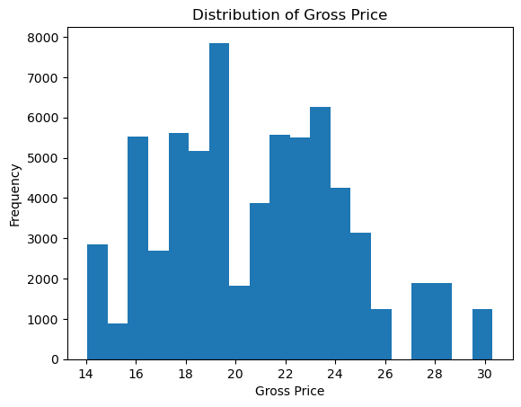
Distribution of Gross Price
Price range: $14 to $30.
Most frequent gross price: $19.
Least frequent gross price: $30.

Slide 4
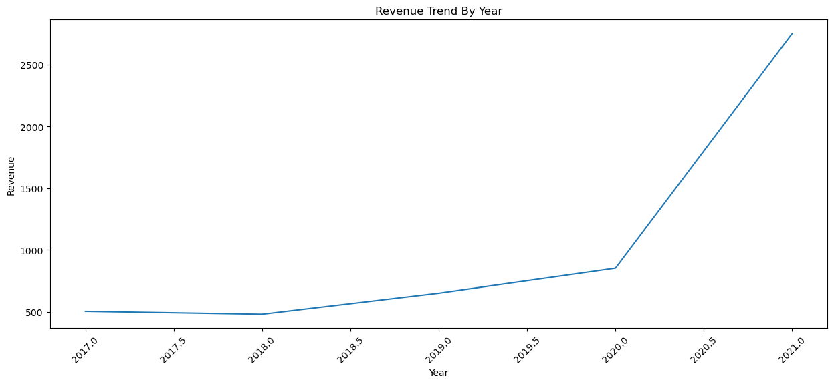
Revenue Trend Over Time
The revenue trend shows a relatively slow increase from 2017 to 2020, with a sharp increase in revenue from 2020 to 2021.

Slide 5
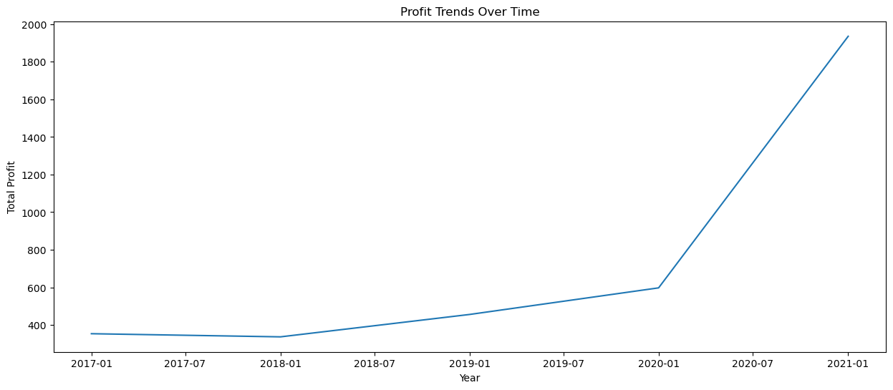
Profit Trend Over Time
The profit margin decreased gradually from 70.28% to 70.18% between January 2017 and January 2020. However, the profit margin showed a sharp increase from January 2020 to January 2021.

Slide 6
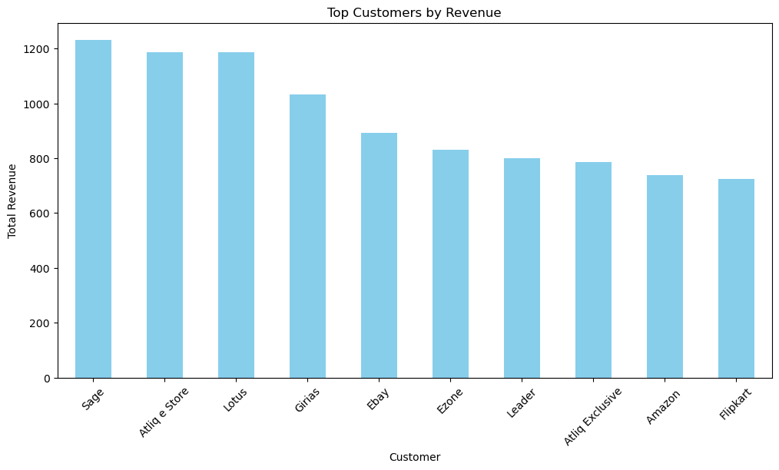
Top Customer by Revenue
The top three revenue contributors among our customer base are Sage, Atliq e Store, and Lotus.

Slide 7
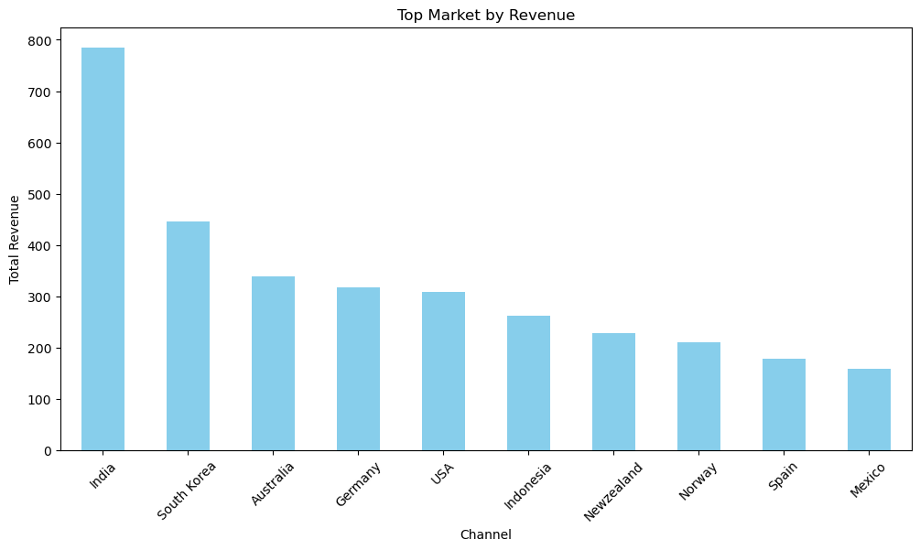
Top Market by Revenue
We've identified that India is our top revenue-contributing market, signaling the importance of maintaining our investments and assets in the Indian market. In contrast, Spain is our lowest-performing market, prompting us to explore strategies for improvement in this region

Slide 8
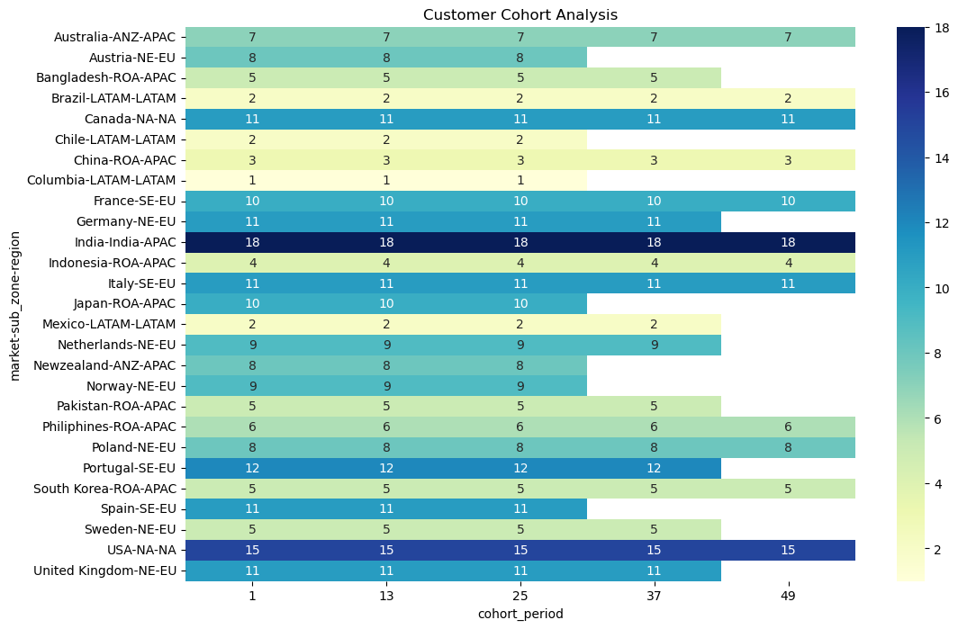
Cohort Result
For segments like "Australia - ANZ - APAC" and "Canada - NA - NA," the average profit remains relatively stable over the cohort periods. This suggests that customers from these segments continue to generate a consistent level of profit over time.
Some segments, like "Austria - NE - EU" and "Japan - ROA - APAC," show a decline in profit. This could indicate a decrease in customer profitability over time within these segments.

Slide 9
Conclusion
The increase in profit margin despite the trend of increasing total cost.
The top customer was Sage, and the top-performing market was India.
Total revenue was $86.56 million, and total profit was $60.87 million.
There is a positive correlation between manufacturing cost and revenue, as products with higher manufacturing costs tend to be of higher quality.

Slide 10
Recommendations
Price Optimization: Given that item prices primarily range from 14 USD to 30 USD, with a peak between 18 USD and 20 USD, consider optimizing your pricing strategy within this range to maximize revenue.
Profit Margin Management: While profit margins remained relatively stable over the four years, this can be an opportunity to focus on margin management. Review your cost structures and pricing strategies to see if there are ways to improve profit margins.
Product Category Focus: Given the positive association between 'profit_margin' and 'category_Graphic Card' and 'category_Internal HDD,' consider allocating more resources to these product categories or expanding your offerings in these areas.
Customer Relationship Management: Continue to nurture relationships with your top revenue contributors, such as Sage, Atliq e Store, and Lotus. Understand their preferences and tailor your strategies to retain and grow their business.
Segmented Approach: The cohort analysis that revealed stable profits in some segments and declining profitability in others provides valuable insights for data-driven decision-making. Implement a segmented approach to address the unique needs and challenges of different customer groups or product lines.

